Slide 1
DATA MINING
DR. Oluwatosin Oluwadare, 2024
Department of Computer Science , University of Colorado, Colorado springs.
CS 4434/5434 and dase 4435
Data Mining,
FALL 2024
Lecture 4-6: Data Preprocessing
Slides Adapted from Jiawei Han et al. Data Mining: Concepts and Techniques, 3rd ed

Slide 2
Data Mining:
Concepts and Techniques
(3rd ed.)
— Chapter 3 —
Jiawei Han, Micheline Kamber, and Jian Pei
University of Illinois at Urbana-Champaign &
Simon Fraser University
©2011 Han, Kamber & Pei. All rights reserved.
2
Notes:
2

Slide 3
Chapter 3: Data Preprocessing
Data Preprocessing: An Overview
  Data Quality
  Major Tasks in Data Preprocessing
Data Cleaning
Data Integration
Data Reduction
Data Transformation and Data Discretization
Summary
3

Slide 4
Why Data Preprocessing?
Data in the real world is dirty
  incomplete: lacking attribute values, lacking certain attributes of interest, or containing only aggregate data
    e.g., occupation=“ ”
  noisy: containing errors or outliers
    e.g., Salary=“-10”
  inconsistent: containing discrepancies in codes or names
    e.g., Age=“42” Birthday=“03/07/1997”
    e.g., Was rating “1,2,3”, now rating “A, B, C”
    e.g., discrepancy between duplicate records

Slide 5
Why Is Data Dirty?
Incomplete data may come from
  “Not applicable” data value when collected
  Different considerations between the time when the data was collected and when it is analyzed.
  Human/hardware/software problems
Noisy data (incorrect values) may come from
  Faulty data collection instruments
  Human or computer error at data entry
  Errors in data transmission
Inconsistent data may come from
  Different data sources
  Functional dependency violation (e.g., modify some linked data)
Duplicate records also need data cleaning

Slide 6
Why Is Data Preprocessing Important?
No quality data, no quality mining results!
  Quality decisions must be based on quality data
    e.g., duplicate or missing data may cause incorrect or even misleading statistics.
  Data warehouse needs consistent integration of quality data
Data extraction, cleaning, and transformation comprises the majority of the work of building a data warehouse.
Low quality data lead to low quality mining result.

Slide 7
Data Quality: Why Preprocess the Data?
Data have quality if they satisfy the requirements of the intended use.
Measures for data quality: A multidimensional view
  Accuracy: correct or wrong, accurate or not
  Completeness: not recorded, unavailable, …
  Consistency: some modified but some not, dangling, …
  Timeliness: timely update?
  Believability: how trustable the data are correct?
  Interpretability: how easily the data can be understood?

Slide 8
Major Tasks in Data Preprocessing
Data cleaning
  Fill in missing values, smooth noisy data, identify or remove outliers, and resolve inconsistencies
Data integration
  Integration of multiple databases, data cubes, or files
Data reduction
  Dimensionality reduction
  Numerosity reduction
  Data compression
Data transformation and data discretization
  Normalization
  Concept hierarchy generation

Slide 9
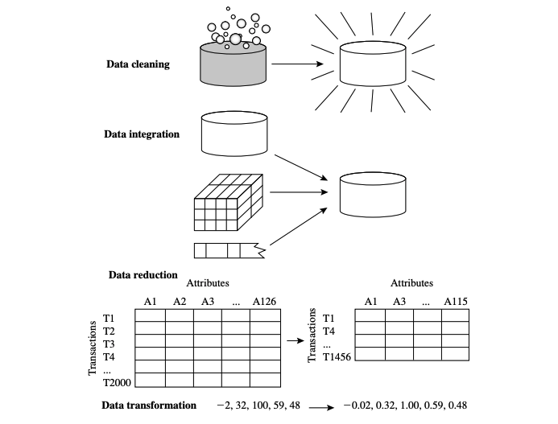
Forms of Data Preprocessing

Slide 10
Chapter 3: Data Preprocessing
Data Preprocessing: An Overview
  Data Quality
  Major Tasks in Data Preprocessing
Data Cleaning
Data Integration
Data Reduction
Data Transformation and Data Discretization
Summary
10

Slide 11
Data Cleaning
Data in the Real World Is Dirty: Lots of potentially incorrect data, e.g., instrument faulty, human or computer error, transmission error
  incomplete: lacking attribute values, lacking certain attributes of interest, or containing only aggregate data
    e.g., Occupation=“ ” (missing data)
  noisy: containing noise, errors, or outliers
    e.g., Salary=“−10” (an error)
  inconsistent: containing discrepancies in codes or names, e.g.,
    Age=“42”, Birthday=“03/07/2010”
    Was rating “1, 2, 3”, now rating “A, B, C”
    discrepancy between duplicate records
  Intentional (e.g., disguised missing data)
    Jan. 1 as everyone’s birthday?

Slide 12
Incomplete (Missing) Data
Data is not always available
  E.g., many tuples have no recorded value for several attributes, such as customer income in sales data
Missing data may be due to
  equipment malfunction
  inconsistent with other recorded data and thus deleted
  data not entered due to misunderstanding
  certain data may not be considered important at the time of entry
  not register history or changes of the data
Missing data may need to be inferred

Slide 13
Customer Data
Name | Age | Sex | Income | Class
Mike | 40 | Male | 150k | Big spender
Jenny | 20 | Female | ? | Regular
…

Slide 14

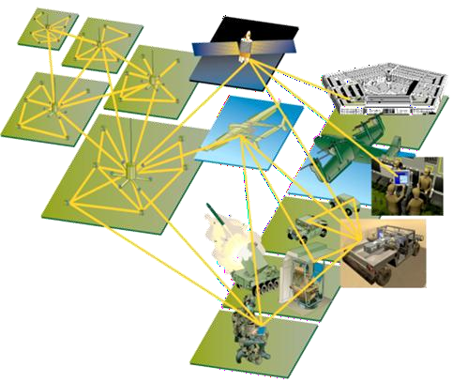
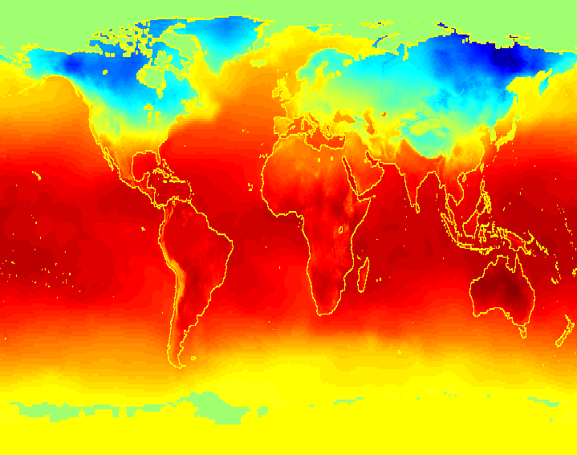
Incomplete (Missing) Data
Data collected and stored at enormous speeds (GB/hour)
  remote sensors on a satellite

Slide 15
How to Handle Missing Data?
Ignore the tuple: usually done when class label is missing (when doing classification)—not effective when the % of missing values per attribute varies considerably
Fill in the missing value manually: tedious + infeasible?
Fill in it automatically with
  a global constant : e.g., “unknown”, a new class?!
  the attribute mean
  the attribute mean for all samples belonging to the same class: smarter
  the most probable value: inference-based such as Bayesian formula or decision tree

Slide 16
Noisy Data
Noise: random error or variance in a measured variable
Incorrect attribute values may be due to
  faulty data collection instruments
  data entry problems
  data transmission problems
  technology limitation
  inconsistency in naming convention
Other data problems which require data cleaning
  duplicate records
  incomplete data
  inconsistent data
16
Notes:
16

Slide 17
How to Handle Noisy Data?
Binning
  first sort data and partition into (equal-frequency) bins
  then one can smooth by bin means, smooth by bin median, smooth by bin boundaries, etc.
Regression
  smooth by fitting the data into regression functions
Clustering
  detect and remove outliers
Combined computer and human inspection
  detect suspicious values and check by human (e.g., deal with possible outliers)

Slide 18
Simple Discretization Methods: Binning
Equal-width (distance) partitioning
  Divides the range into N intervals of equal size: uniform grid
  if A and B are the lowest and highest values of the attribute, the width of intervals will be: W = (B –A)/N.
  The most straightforward, but outliers may dominate presentation
  Skewed data is not handled well
Equal-depth (frequency) partitioning
  Divides the range into N intervals, each containing approximately same number of samples
  Good data scaling

Slide 19
Binning Methods for Data Smoothing
Sorted data for price (in dollars): 4, 8, 9, 15, 21, 21, 24, 25, 26, 28, 29, 34
* Partition into equal-frequency (equi-depth) bins:
- Bin 1: 4, 8, 9, 15
- Bin 2: 21, 21, 24, 25
- Bin 3: 26, 28, 29, 34
* Smoothing by bin means:
- Bin 1: 9, 9, 9, 9
- Bin 2: 23, 23, 23, 23
- Bin 3: 29, 29, 29, 29
* Smoothing by bin boundaries:
- Bin 1: 4, 4, 4, 15
- Bin 2: 21, 21, 25, 25
- Bin 3: 26, 26, 26, 34

Slide 20
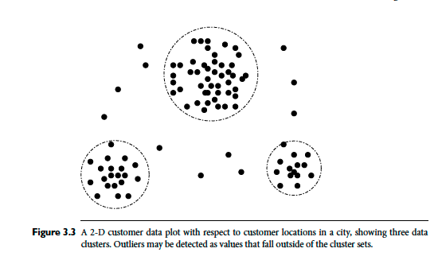
How to Handle Noisy Data?

Slide 21
Data Cleaning as a Process
Data discrepancy detection
  Use metadata (e.g., domain, range, dependency, distribution)
  Check field overloading
  Check uniqueness rule, consecutive rule and null rule
  Use commercial tools
    Data scrubbing: use simple domain knowledge (e.g., postal code, spell-check) to detect errors and make corrections
    Data auditing: by analyzing data to discover rules and relationship to detect violators (e.g., correlation and clustering to find outliers)
Data migration and integration
  Data migration tools: allow transformations to be specified
  ETL (Extraction/Transformation/Loading) tools: allow users to specify transformations through a graphical user interface
Integration of the two processes
  Iterative and interactive (e.g., Potter’s Wheels)

Slide 22
Chapter 3: Data Preprocessing
Data Preprocessing: An Overview
  Data Quality
  Major Tasks in Data Preprocessing
Data Cleaning
Data Integration
Data Reduction
Data Transformation and Data Discretization
Summary
22

Slide 23
Data Integration
Data integration:
  Combines data from multiple sources into a coherent store
Schema integration: e.g., A.cust-id ≡ B.cust-#
  Integrate metadata from different sources
Entity identification problem:
  Identify real world entities from multiple data sources, e.g., Bill Clinton = William Clinton
Detecting and resolving data value conflicts
  For the same real world entity, attribute values from different sources are different
  Possible reasons: different representations, different scales, e.g., metric vs. British units
23

Slide 24
Handling Redundancy in Data Integration
Redundant data occur often when integration of multiple databases
  Object identification: The same attribute or object may have different names in different databases
  Derivable data: One attribute may be a “derived” attribute in another table, e.g., annual revenue
Redundant attributes may be able to be detected by correlation analysis and covariance analysis
Careful integration of the data from multiple sources may help reduce/avoid redundancies and inconsistencies and improve mining speed and quality
24
Notes:
An attribute (such as annual revenue, for instance) may be redundant if it can be “derived” from another attribute or set of attributes. Inconsistencies in attribute or dimension naming can also cause redundancies in the resulting data set.

Slide 25
Correlation Analysis (Nominal Data)
Χ² (chi-square) test
The larger the Χ² value, the more likely the variables are related
The cells that contribute the most to the Χ² value are those whose actual count is very different from the expected count
Correlation does not imply causality
  # of hospitals and # of car-theft in a city are correlated
  Both are causally linked to the third variable: population

Slide 26
Chi-Square Calculation: An Example
 | Play chess | Not play chess | Sum (row)
Like science fiction | 250 | 200 | 450
Not like science fiction | 50 | 1000 | 1050
Sum(col.) | 300 | 1200 | 1500

Slide 27
Chi-Square Calculation: An Example
Steps to follow
  State the hypothesis
  Establish the significance level you need (p = 0.001, 99.9% confidence level) and the number of degrees of freedom
  Calculate the expected values
  Use the observed and expected values to calculate the chi-square test statistic
  Compare the chi-square statistic with the critical value from the table
  Make a decision about your hypothesis

Slide 28
Hypothesis
 | Play chess | Not play chess | Sum (row)
Like science fiction | 250 | 200 | 450
Not like science fiction | 50 | 1000 | 1050
Sum(col.) | 300 | 1200 | 1500
H₀ : Chess Playing or not and preferred reading are independent(no association).
H₁ : Chess Playing or not and preferred reading are not independent(association).

Slide 29
Degrees of freedom
Significance level, p = 0.001
Number of degrees of freedom is calculated by multiplying the number of rows minus 1 by the number of columns minus 1
  Degree of freedom = (r -1) x (c-1)
  For a 2 x 2 contingency table:
    (2-1) x (2-1) = 1

Slide 30
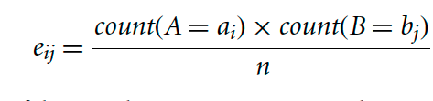
Expected Values
Observed Values
 | Play chess | Not play chess | Sum (row)
Like science fiction | 250 | 200 | 450
Not like science fiction | 50 | 1000 | 1050
Sum(col.) | 300 | 1200 | 1500
Expected Values
 | Play chess | Not play chess | Sum (row)
Like science fiction | 90 | 360 | 450
Not like science fiction | 210 | 840 | 1050
Sum(col.) | 300 | 1200 | 1500

Slide 31
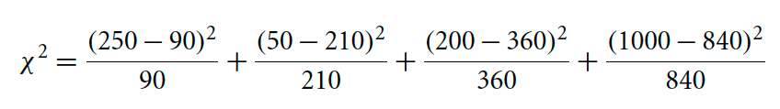
Calculation
= 284.44 + 121.90 + 71.11+ 30.48
= 507.93

Slide 32
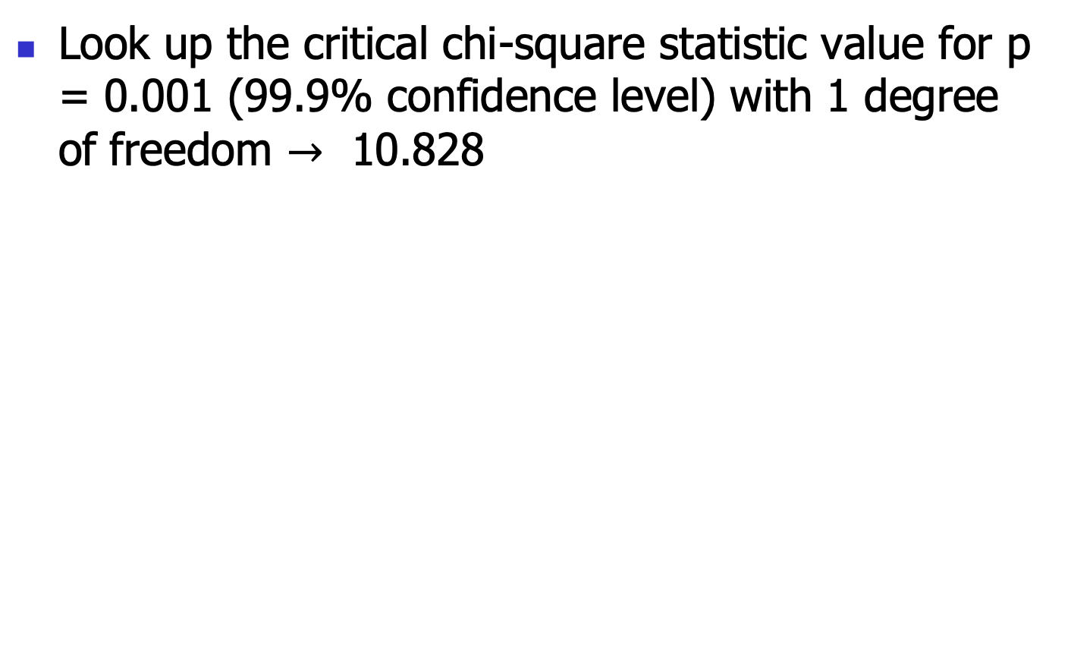
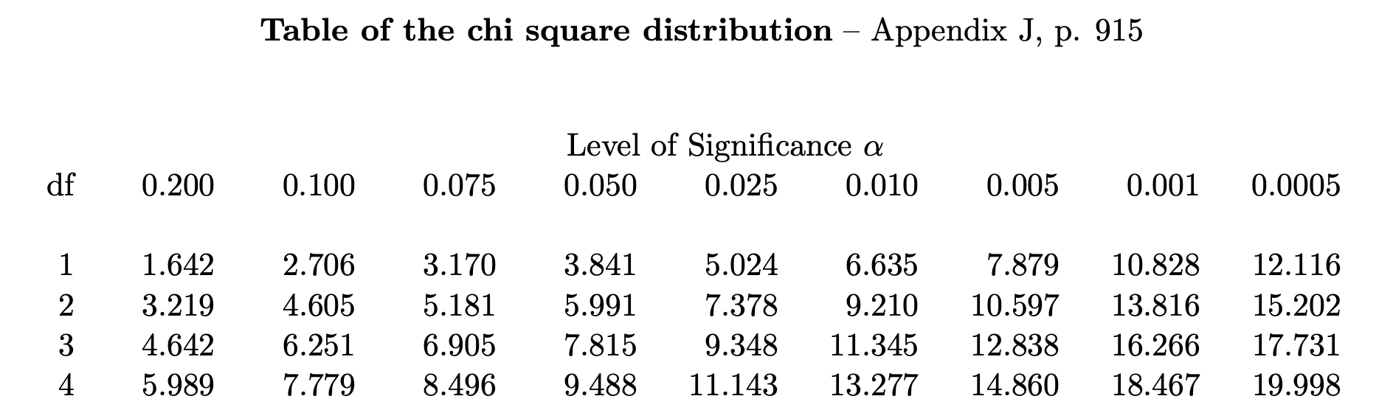
Table of Critical values
?

Slide 33
Make a Decision: Is it Significant?
Test value > table value then REJECT H₀
507.93 > 10.828
We reject H₀ ’ Chess Playing or not and preferred reading are independent’
Instead, we conclude that the two attributes are (strongly) correlated for the given group of people.

Slide 34
Chi-Square Calculation: An Example
Χ² (chi-square) calculation (numbers in parenthesis are expected counts calculated based on the data distribution in the two categories)
It shows that like_science_fiction and play_chess are correlated in the group
 | Play chess | Not play chess | Sum (row)
Like science fiction | 250(90) | 200(360) | 450
Not like science fiction | 50(210) | 1000(840) | 1050
Sum(col.) | 300 | 1200 | 1500

Slide 35
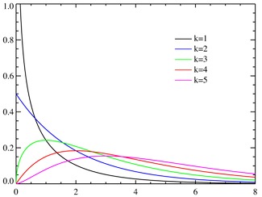
Chi Square Distribution
Degree of freedom = 1 (e.g., (r − 1)(c − 1))
For 0.001 significance, threshold = 10.828
http://en.wikipedia.org/wiki/Pearson's_chi-squared_test

Slide 36
Correlation Analysis (Numeric Data)
Correlation coefficient (also called Pearson’s product moment coefficient)
  where n is the number of tuples, and are the respective means of A and B, σ_{A} and σ_{B} are the respective standard deviation of A and B, and Σ(a_{i}b_{i}) is the sum of the AB cross-product.
If r_{A,B} > 0, A and B are positively correlated (A’s values increase as B’s). The higher, the stronger correlation.
r_{A,B} = 0: independent; r_{AB} < 0: negatively correlated

Slide 37
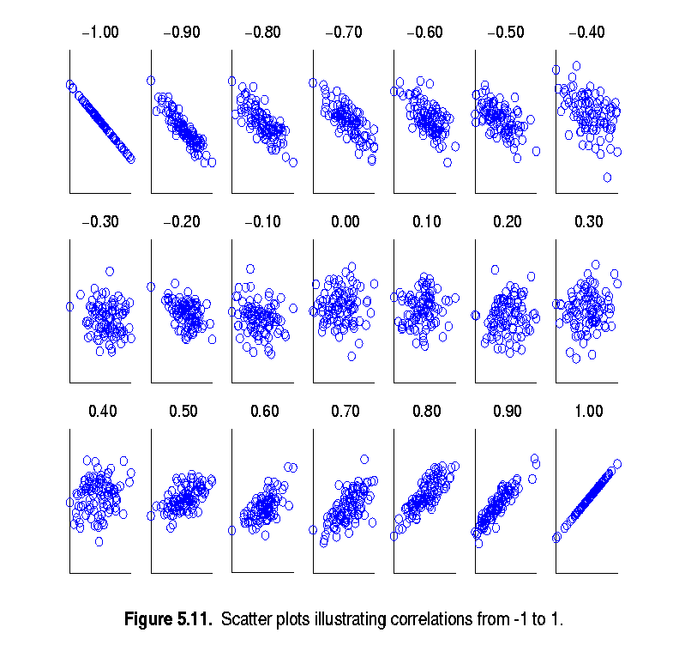
Visually Evaluating Correlation
Scatter plots showing the similarity from –1 to 1.

Slide 38
Correlation (viewed as linear relationship)
Correlation measures the linear relationship between objects
To compute correlation, we standardize data objects, A and B, and then take their dot product

Slide 39
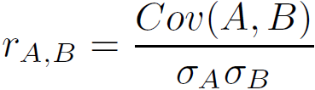
Covariance (Numeric Data)
Covariance is similar to correlation
  where n is the number of tuples, and are the respective mean or expected values of A and B, σ_{A} and σ_{B} are the respective standard deviation of A and B.
Positive covariance: If Cov_{A,B} > 0, then A and B both tend to be larger than their expected values.
Negative covariance: If Cov_{A,B} < 0 then if A is larger than its expected value, B is likely to be smaller than its expected value.
Independence: Cov_{A,B} = 0 but the converse is not true:
  Some pairs of random variables may have a covariance of 0 but are not independent. Only under some additional assumptions (e.g., the data follow multivariate normal distributions) does a covariance of 0 imply independence
Correlation coefficient:

Slide 40

Co-Variance: An Example
It can be simplified in computation as
Suppose two stocks A and B have the following values in one week: (2, 5), (3, 8), (5, 10), (4, 11), (6, 14).
Question: If the stocks are affected by the same industry trends, will their prices rise or fall together?
  E(A) = (2 + 3 + 5 + 4 + 6)/ 5 = 20/5 = 4
  E(B) = (5 + 8 + 10 + 11 + 14) /5 = 48/5 = 9.6
  Cov(A,B) = (2×5+3×8+5×10+4×11+6×14)/5 − 4 × 9.6 = 4
Thus, A and B rise together since Cov(A, B) > 0.

Slide 41
Chapter 3: Data Preprocessing
Data Preprocessing: An Overview
  Data Quality
  Major Tasks in Data Preprocessing
Data Cleaning
Data Integration (Lecture 5)
Data Reduction
Data Transformation and Data Discretization
Summary
41
Notes:
41

Slide 42
Data Reduction Strategies
Data reduction: Obtain a reduced representation of the data set that is much smaller in volume but yet produces the same (or almost the same) analytical results
Why data reduction? — A database/data warehouse may store terabytes of data. Complex data analysis may take a very long time to run on the complete data set.
Data reduction strategies
  Dimensionality reduction, e.g., remove unimportant attributes
    Wavelet transforms
    Principal Components Analysis (PCA)
    Feature subset selection, feature creation
  Numerosity reduction (some simply call it: Data Reduction)
    Regression and Log-Linear Models
    Histograms, clustering, sampling
    Data cube aggregation
  Data compression

Slide 43
Data Reduction 1: Dimensionality Reduction
Curse of dimensionality
  When dimensionality increases, data becomes increasingly sparse
  Density and distance between points, which is critical to clustering, outlier analysis, becomes less meaningful
  The possible combinations of subspaces will grow exponentially
Dimensionality reduction
  Avoid the curse of dimensionality
  Help eliminate irrelevant features and reduce noise
  Reduce time and space required in data mining
  Allow easier visualization
Dimensionality reduction techniques
  Wavelet transforms
  Principal Component Analysis
  Supervised and nonlinear techniques (e.g., feature selection)
Notes:
43

Slide 44
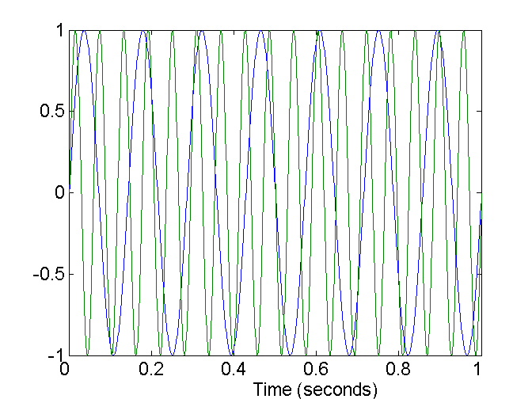
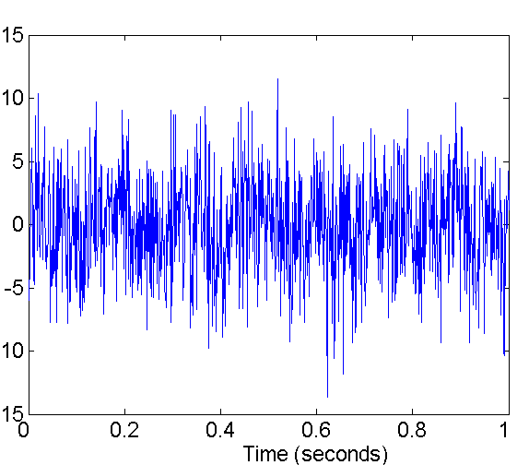
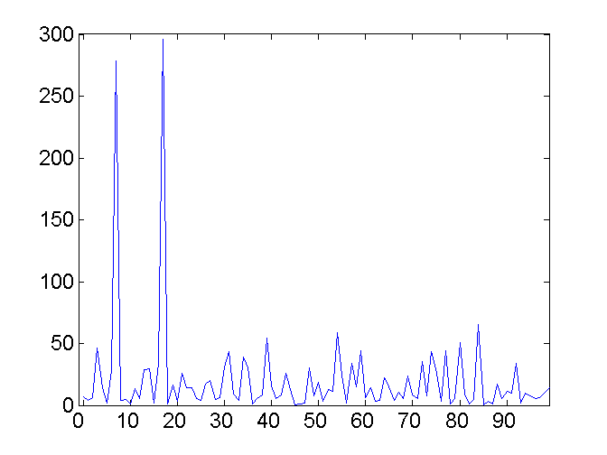
Mapping Data to a New Space
Fourier transform
Wavelet transform
Two Sine Waves
Two Sine Waves + Noise
Frequency
Notes:
44

Slide 45
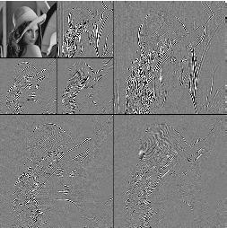
What Is Wavelet Transform?
Decomposes a signal into different frequency sub-bands
  Applicable to n-dimensional signals
Data are transformed to preserve relative distance between objects at different levels of resolution
Allow natural clusters to become more distinguishable
Used for image compression
Notes:
45

Slide 46
(1) Wavelet Transformation
Haar2
Daubechie4
Discrete wavelet transform (DWT) for linear signal processing, multi-resolution analysis
Compressed approximation: store only a small fraction of the strongest of the wavelet coefficients
Similar to discrete Fourier transform (DFT), but better lossy compression, localized in space
Method:
  Length, L, must be an integer power of 2 (padding with 0’s, when necessary)
  Each transform has 2 functions: smoothing, difference
  Applies to pairs of data, resulting in two set of data of length L/2
  Applies two functions recursively, until reaches the desired length
Notes:
46

Slide 47
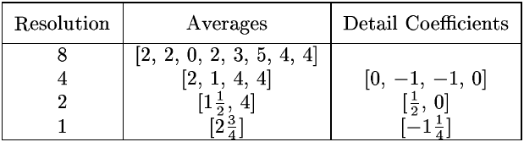
Wavelet Decomposition
Wavelets: A math tool for space-efficient hierarchical decomposition of functions
S = [2, 2, 0, 2, 3, 5, 4, 4] can be transformed to S^ = [2³/₄, -1¹/₄, ¹/₂, 0, 0, -1, -1, 0]
Compression: many small detail coefficients can be replaced by 0’s, and only the significant coefficients are retained
Notes:
47

Slide 48
Haar Wavelet Coefficients
Coefficient “Supports”
₊
Hierarchical decomposition structure (a.k.a. “error tree”)
2.75
₋
2.75
₊
+
-1.25
₋
+
-1.25
-
₊
0.5
₋
0.5
0
₊
+
-
+
-
0
₋
0
-1
-1
0
₊
0
₋
+
-
+
-
+
-
+
-
₊
₋
-1
2 2 0 2 3 5 4 4
₊
-1
₋
₊
Original frequency distribution
0
Notes:
48

Slide 49
Why Wavelet Transform?
Use hat-shape filters
  Emphasize region where points cluster
  Suppress weaker information in their boundaries
Effective removal of outliers
  Insensitive to noise, insensitive to input order
Multi-resolution
  Detect arbitrary shaped clusters at different scales
Efficient
  Complexity O(N)
Only applicable to low dimensional data
Notes:
49

Slide 50
Why Wavelet Transform?
Wavelet transforms give good results on sparse or skewed data and on data with ordered attributes.
Wavelet transforms have many real-world applications, including the compression of fingerprint images, computer vision, analysis of time-series data, and data cleaning

Slide 51
(2) Principal Component Analysis (PCA)
Find a projection that captures the largest amount of variation in data
The original data are projected onto a much smaller space, resulting in dimensionality reduction.
We find the eigenvectors of the covariance matrix, and these eigenvectors define the new space
x₂
e
x₁

Slide 52
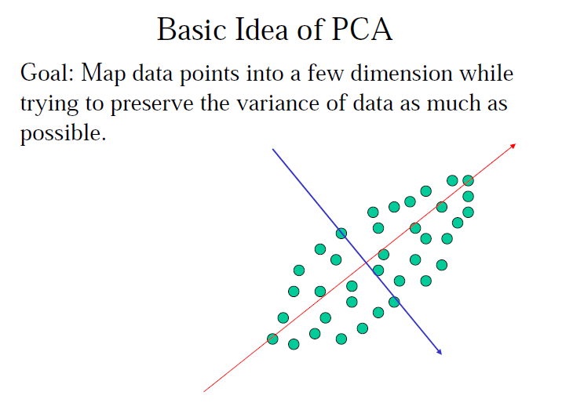
Principal Component Analysis (PCA)

Slide 53
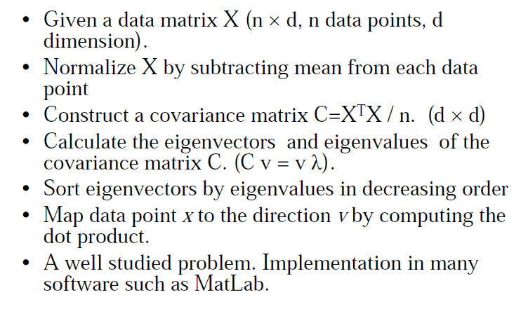
PCA Method
Notes:
More Resources: https://www.youtube.com/watch?v=8UX82qVJzYI

Slide 54
Principal Component Analysis (Steps)
Given N data vectors from n-dimensions, find k ≤ n orthogonal vectors (principal components) that can be best used to represent data
  Normalize input data: Each attribute falls within the same range
  Compute k orthonormal (unit) vectors, i.e., principal components
  Each input data (vector) is a linear combination of the k principal component vectors
  The principal components are sorted in order of decreasing “significance” or strength
  Since the components are sorted, the size of the data can be reduced by eliminating the weak components, i.e., those with low variance (i.e., using the strongest principal components, it is possible to reconstruct a good approximation of the original data)
Works for numeric data only

Slide 55
Principal Component Analysis
X2
Y1
Y2
X1

Slide 56
(3) Attribute Subset Selection
Another way to reduce dimensionality of data
Redundant attributes
  Duplicate much or all of the information contained in one or more other attributes
  E.g., purchase price of a product and the amount of sales tax paid
Irrelevant attributes
  Contain no information that is useful for the data mining task at hand
  E.g., students' ID is often irrelevant to the task of predicting students' GPA

Slide 57
Heuristic Search in Attribute Selection
There are 2^{d} possible attribute combinations of d attributes
Typical heuristic attribute selection methods:
  Best single attribute under the attribute independence assumption: choose by significance tests
  Best step-wise feature selection:
    The best single-attribute is picked first
    Then next best attribute condition to the first, ...
  Step-wise attribute elimination:
    Repeatedly eliminate the worst attribute
  Best combined attribute selection and elimination
  Optimal branch and bound:
    Use attribute elimination and backtracking

Slide 58
(4) Attribute Creation (Feature Generation)
58
Create new attributes (features) that can capture the important information in a data set more effectively than the original ones
Three general methodologies
  Attribute extraction
    Domain-specific
  Mapping data to new space (see: data reduction)
    E.g., Fourier transformation, wavelet transformation, manifold approaches (not covered)
  Attribute construction
    Combining features (see: discriminative frequent patterns in Chapter 7)
    Data discretization
Notes:
58

Slide 59
Data Reduction 2: Numerosity Reduction
Reduce data volume by choosing alternative, smaller forms of data representation
Parametric methods (e.g., regression)
  Assume the data fits some model, estimate model parameters, store only the parameters, and discard the data (except possible outliers)
  Ex.: Log-linear models—obtain value at a point in m-D space as the product on appropriate marginal subspaces
Non-parametric methods
  Do not assume models
  Major families: histograms, clustering, sampling, …

Slide 60
Parametric Data Reduction: Regression and Log-Linear Models
Linear regression
  Data modeled to fit a straight line
  Often uses the least-square method to fit the line
Multiple regression
  Allows a response variable Y to be modeled as a linear function of multidimensional feature vector
Log-linear model
  Approximates discrete multidimensional probability distributions

Slide 61
(1) Regression Analysis
y
Y1
Regression analysis: A collective name for techniques for the modeling and analysis of numerical data consisting of values of a dependent variable (also called response variable or measurement) and of one or more independent variables (aka. explanatory variables or predictors)
The parameters are estimated so as to give a "best fit" of the data
Most commonly the best fit is evaluated by using the least squares method, but other criteria have also been used
Y1’
y = x + 1
X1
x
Used for prediction (including forecasting of time-series data), inference, hypothesis testing, and modeling of causal relationships

Slide 62
Regress Analysis and Log-Linear Models
Linear regression: Y = w X + b
  Two regression coefficients, w and b, specify the line and are to be estimated by using the data at hand
  Using the least squares criterion to the known values of Y₁, Y₂, …, X₁, X₂, ….
Multiple regression: Y = b₀ + b₁ X₁ + b₂ X₂
  Many nonlinear functions can be transformed into the above
Log-linear models:
  Approximate discrete multidimensional probability distributions
  Estimate the probability of each point (tuple) in a multi-dimensional space for a set of discretized attributes, based on a smaller subset of dimensional combinations
  Useful for dimensionality reduction and data smoothing

Slide 63
(2) Histogram Analysis
Divide data into buckets and store average (sum) for each bucket
Partitioning rules:
  Equal-width: equal bucket range
  Equal-frequency (or equal-depth)

Slide 64
(3) Clustering
Partition data set into clusters based on similarity, and store cluster representation (e.g., centroid and diameter) only
Can be very effective if data is clustered but not if data is “smeared”
Can have hierarchical clustering and be stored in multi-dimensional index tree structures
There are many choices of clustering definitions and clustering algorithms
Cluster analysis will be studied in depth in Chapter 10

Slide 65
Cluster Analysis

Slide 66
(4) Sampling
Sampling: obtaining a small sample s to represent the whole data set N
Allow a mining algorithm to run in complexity that is potentially sub-linear to the size of the data
Key principle: Choose a representative subset of the data
  Simple random sampling may have very poor performance in the presence of skew
  Develop adaptive sampling methods, e.g., stratified sampling:
Note: Sampling may not reduce database I/Os (page at a time)

Slide 67
Types of Sampling
Simple random sampling
  There is an equal probability of selecting any particular item
Sampling without replacement
  Once an object is selected, it is removed from the population
Sampling with replacement
  A selected object is not removed from the population
Stratified sampling:
  Partition the data set, and draw samples from each partition (proportionally, i.e., approximately the same percentage of the data)
  Used in conjunction with skewed data

Slide 68
Sampling: With or without Replacement
SRSWOR
(simple random
sample without
replacement)
SRSWR
Raw Data

Slide 69
Sampling: Cluster or Stratified Sampling
Raw Data
Cluster/Stratified Sample

Slide 70
Data Cube Aggregation
The lowest level of a data cube (base cuboid)
  The aggregated data for an individual entity of interest
  E.g., a customer in a phone calling data warehouse
Multiple levels of aggregation in data cubes
  Further reduce the size of data to deal with
Reference appropriate levels
  Use the smallest representation which is enough to solve the task
Queries regarding aggregated information should be answered using data cube, when possible
Notes:
70

Slide 71
Data Reduction 3: Data Compression
String compression
  There are extensive theories and well-tuned algorithms
  Typically lossless, but only limited manipulation is possible without expansion
Audio/video compression
  Typically lossy compression, with progressive refinement
  Sometimes small fragments of signal can be reconstructed without reconstructing the whole
Time sequence is not audio
  Typically short and vary slowly with time
Dimensionality and numerosity reduction may also be considered as forms of data compression
Notes:
71

Slide 72
Data Compression
Original Data
Compressed
Data
lossless
Original Data
Approximated
lossy
Notes:
72

Slide 73
Chapter 3: Data Preprocessing
Data Preprocessing: An Overview
  Data Quality
  Major Tasks in Data Preprocessing
Data Cleaning
Data Integration
Data Reduction
Data Transformation and Data Discretization
Summary
Notes:
73

Slide 74
Data Transformation
A function that maps the entire set of values of a given attribute to a new set of replacement values s.t. each old value can be identified with one of the new values
Methods
  Smoothing: Remove noise from data
  Attribute/feature construction
    New attributes constructed from the given ones
  Aggregation: Summarization, data cube construction
  Normalization: Scaled to fall within a smaller, specified range
    min-max normalization
    z-score normalization
    normalization by decimal scaling
  Discretization: Concept hierarchy climbing
Notes:
74

Slide 75
Data Transformation: Normalization
Min-max normalization: to [new_min_{A}, new_max_{A}]
  Ex. Let income range $12,000 to $98,000 normalized to [0.0, 1.0]. Then $73,000 is mapped to
Z-score normalization (μ: mean, σ: standard deviation):
  Ex. Let μ = 54,000, σ = 16,000. Then
Normalization by decimal scaling
Where j is the smallest integer such that Max(|ν’|) < 1

Slide 76
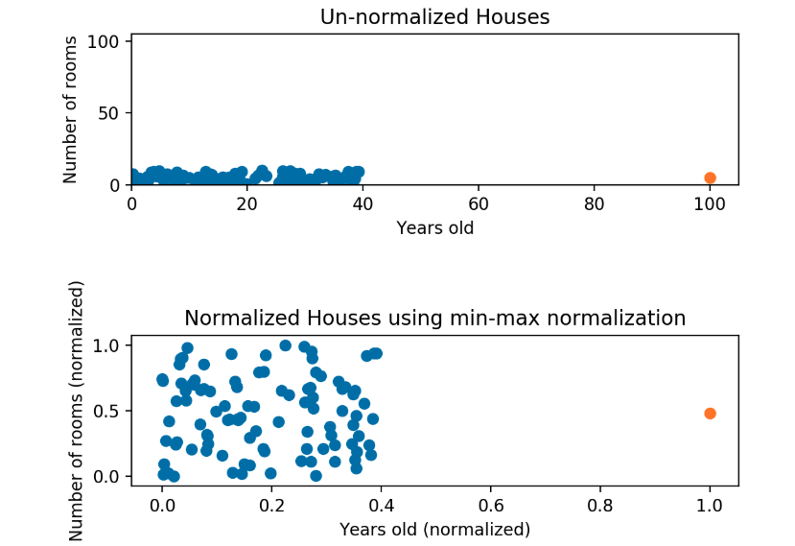
Normalization

Slide 77
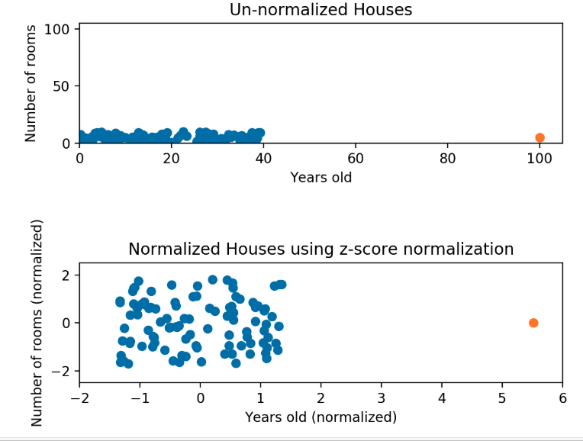
Normalization : Z-Score

Slide 78
Normalization
Min-Max
Z-Score

Slide 79
Discretization
Three types of attributes
  Nominal—values from an unordered set, e.g., color, profession
  Ordinal—values from an ordered set, e.g., military or academic rank
  Numeric—real numbers, e.g., integer or real numbers
Discretization: Divide the range of a continuous attribute into intervals
  Interval labels can then be used to replace actual data values
  Reduce data size by discretization
  Supervised vs. unsupervised
  Split (top-down) vs. merge (bottom-up)
  Discretization can be performed recursively on an attribute
  Prepare for further analysis, e.g., classification

Slide 80
Discretization
For example, we can divide a continuous variable, weight, and store it in the following groups:
  Under 100 lbs (light),
  between 140–160 lbs (mid),
  and over 200 lbs (heavy)
Therefore, discretization helps make our data easier to understand if it fits the problem statement.

Slide 81
Data Discretization Methods
Typical methods: All the methods can be applied recursively
  Binning
    Top-down split, unsupervised
  Histogram analysis
    Top-down split, unsupervised
  Clustering analysis (unsupervised, top-down split or bottom-up merge)
  Decision-tree analysis (supervised, top-down split)
  Correlation (e.g., χ²) analysis (unsupervised, bottom-up merge)
81
Notes:
81

Slide 82
Simple Discretization: Binning
Equal-width (distance) partitioning
  Divides the range into N intervals of equal size: uniform grid
  if A and B are the lowest and highest values of the attribute, the width of intervals will be: W = (B –A)/N.
  The most straightforward, but outliers may dominate presentation
  Skewed data is not handled well
Equal-depth (frequency) partitioning
  Divides the range into N intervals, each containing approximately same number of samples
  Good data scaling
  Managing categorical attributes can be tricky

Slide 83
Binning Methods for Data Smoothing
Sorted data for price (in dollars): 4, 8, 9, 15, 21, 21, 24, 25, 26, 28, 29, 34
* Partition into equal-frequency (equi-depth) bins:
- Bin 1: 4, 8, 9, 15
- Bin 2: 21, 21, 24, 25
- Bin 3: 26, 28, 29, 34
* Smoothing by bin means:
- Bin 1: 9, 9, 9, 9
- Bin 2: 23, 23, 23, 23
- Bin 3: 29, 29, 29, 29
* Smoothing by bin boundaries:
- Bin 1: 4, 4, 4, 15
- Bin 2: 21, 21, 25, 25
- Bin 3: 26, 26, 26, 34

Slide 84
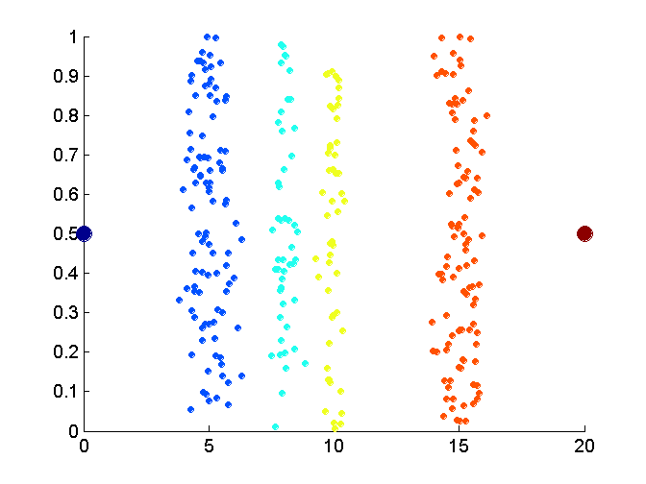
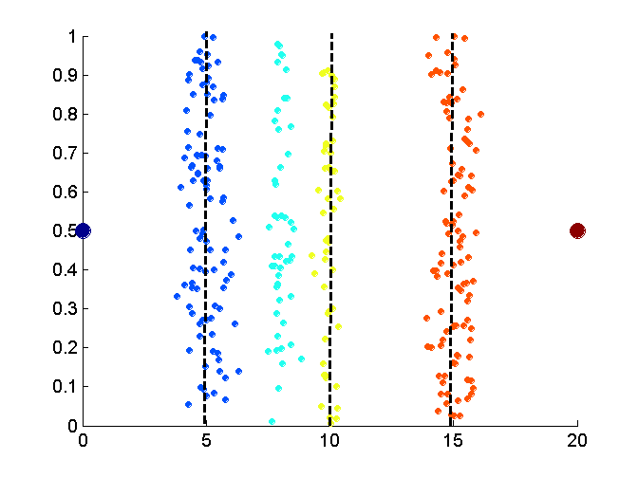
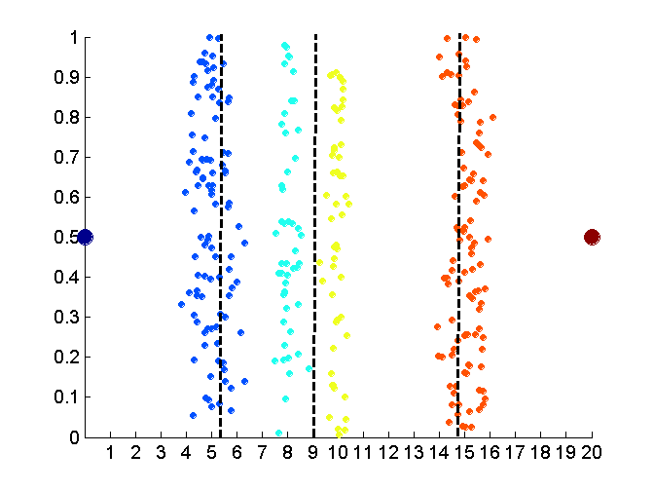
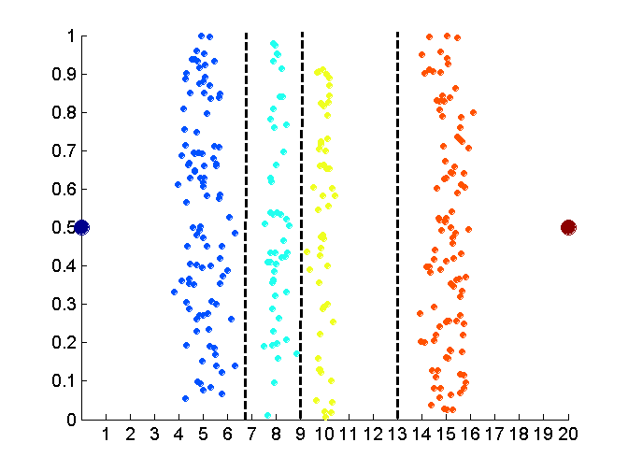
Discretization Without Using Class Labels
(Binning vs. Clustering)
Data
Equal interval width (binning)
Equal frequency (binning)
K-means clustering leads to better results
84
Notes:
84

Slide 85
Discretization by Classification & Correlation Analysis
Classification (e.g., decision tree analysis)
  Supervised: Given class labels, e.g., cancerous vs. benign
  Using entropy to determine split point (discretization point)
  Top-down, recursive split
  Details to be covered in Chapter 7
Correlation analysis (e.g., Chi-merge: χ²-based discretization)
  Supervised: use class information
  Bottom-up merge: find the best neighboring intervals (those having similar distributions of classes, i.e., low χ² values) to merge
  Merge performed recursively, until a predefined stopping condition
85
Notes:
85

Slide 86
Concept Hierarchy Generation
Concept hierarchy organizes concepts (i.e., attribute values) hierarchically and is usually associated with each dimension in a data warehouse
Concept hierarchies facilitate drilling and rolling in data warehouses to view data in multiple granularity
Concept hierarchy formation: Recursively reduce the data by collecting and replacing low level concepts (such as numeric values for age) by higher level concepts (such as youth, adult, or senior)
Concept hierarchies can be explicitly specified by domain experts and/or data warehouse designers
Concept hierarchy can be automatically formed for both numeric and nominal data.
For numeric data, use discretization methods shown.

Slide 87
Concept Hierarchy Generation for Nominal Data
Specification of a partial/total ordering of attributes explicitly at the schema level by users or experts
  street < city < state < country
Specification of a hierarchy for a set of values by explicit data grouping
  {Urbana, Champaign, Chicago} < Illinois
Specification of only a partial set of attributes
  E.g., only street < city, not others
Automatic generation of hierarchies (or attribute levels) by the analysis of the number of distinct values
  E.g., for a set of attributes: {street, city, state, country}

Slide 88
Automatic Concept Hierarchy Generation
Some hierarchies can be automatically generated based on the analysis of the number of distinct values per attribute in the data set
  The attribute with the most distinct values is placed at the lowest level of the hierarchy
  Exceptions, e.g., weekday, month, quarter, year
country
15 distinct values
province_or_ state
365 distinct values
city
3567 distinct values
street
674,339 distinct values

Slide 89
Chapter 3: Data Preprocessing
Data Preprocessing: An Overview
  Data Quality
  Major Tasks in Data Preprocessing
Data Cleaning
Data Integration
Data Reduction
Data Transformation and Data Discretization
Summary
Notes:
89

Slide 90
Summary
Data quality: accuracy, completeness, consistency, timeliness, believability, interpretability
Data cleaning: e.g. missing/noisy values, outliers
Data integration from multiple sources:
  Entity identification problem
  Remove redundancies
  Detect inconsistencies
Data reduction
  Dimensionality reduction
  Numerosity reduction
  Data compression
Data transformation and data discretization
  Normalization
  Concept hierarchy generation

Slide 91
References
D. P. Ballou and G. K. Tayi. Enhancing data quality in data warehouse environments. Comm. of ACM, 42:73-78, 1999
A. Bruce, D. Donoho, and H.-Y. Gao. Wavelet analysis. IEEE Spectrum, Oct 1996
T. Dasu and T. Johnson. Exploratory Data Mining and Data Cleaning. John Wiley, 2003
J. Devore and R. Peck. Statistics: The Exploration and Analysis of Data. Duxbury Press, 1997.
H. Galhardas, D. Florescu, D. Shasha, E. Simon, and C.-A. Saita. Declarative data cleaning: Language, model, and algorithms. VLDB'01
M. Hua and J. Pei. Cleaning disguised missing data: A heuristic approach. KDD'07
H. V. Jagadish, et al., Special Issue on Data Reduction Techniques. Bulletin of the Technical Committee on Data Engineering, 20(4), Dec. 1997
H. Liu and H. Motoda (eds.). Feature Extraction, Construction, and Selection: A Data Mining Perspective. Kluwer Academic, 1998
J. E. Olson. Data Quality: The Accuracy Dimension. Morgan Kaufmann, 2003
D. Pyle. Data Preparation for Data Mining. Morgan Kaufmann, 1999
V. Raman and J. Hellerstein. Potters Wheel: An Interactive Framework for Data Cleaning and Transformation, VLDB’2001
T. Redman. Data Quality: The Field Guide. Digital Press (Elsevier), 2001
R. Wang, V. Storey, and C. Firth. A framework for analysis of data quality research. IEEE Trans. Knowledge and Data Engineering, 7:623-640, 1995

